Slide 1
Lead Scoring Case Study
Presented by:
ABHISHEK AGRAWAL

Slide 2
Table of CONTENTS
Problem Statement
Work flow
Importing libraries and warnings
Reading datasets
Handling of null values
Outliers handling
Univariate analysis
Bivariate analysis
Conclusion

Slide 3
PROBLEM STATEMENT
To help X education to select the most promising leads known as ‘hot leads’ who are most likely to convert into paid customers.
Build a logistic regression model to assign a lead score between 0 and 100 to each of the leads where the leads with higher lead score have a higher conversion chance and the leads with lower lead score have a lower conversion chance.
Identify the driver variables and understand their significance which are strong indicators of lead conversion. • Identify the outliers, if any, in the dataset and justify the same.
Consider both technical and business aspects while building the model.
Summarize the conversion predictions by using evaluation metrics like accuracy, sensitivity, specificity and precision.

Slide 4
WOR K FLOW
Importing libraries & warnings
Identifying missing and null values
Eliminating missing and null values
Importing data files
Creating Dummy Variable
Model Building
Scaling
Split the data Train and test
Drop the original variables
Finding Optimal Cut Off
Making Predictions on Test Set
Conclusion
Model Evolution

Slide 5
IMPORTING LIBRARIES AND WARNINGS
Importing libraries
Imported pandas, numpy, matplotlib & seaborn for data loading & visualization
Imported sklearn for model building and statsmodels for model evolution.
Importing Warnings Highlights warnings however the program runs.

Slide 6
READING DATASET
Datafile is extracted from the given dataset. namely 'Leads.csv’
Highlighted datafile description, shape etc., in the notebook for elaborated experience in reading the data.

Slide 7
Data Cleaning and Preparation
Leads.csv :
Following columns contain more than 3000 null values initially, hence dropped those columns:
Tags
Lead Quality
Asymmetrique Activity Index
Asymmetrique Profile Index
Asymmetrique Activity Score
Asymmetrique Profile Score

Slide 8
Dummy Variable Creation
Check the columns which are of type 'object’
Create dummy variables using the 'get_dummies' command for following columns 'Lead Origin', 'Lead Source', 'Do Not Email', 'Last Activity’, 'What is your current occupation’, 'A free copy of Mastering The Interview', 'Last Notable Activity'
Add the results to the master dataframe
Creating dummy variable separately for the variable 'Specialization’
Drop the variables for which the dummy variables have been created
Test - Train Split & SCALING
Put all the feature variables in X
Put the target variable in y
Split the dataset into 70% train and 30% test
Scale the three numeric features i.e. 'TotalVisits', 'Page Views Per Visit', 'Total Time Spent on Website' present in the dataset

Slide 9
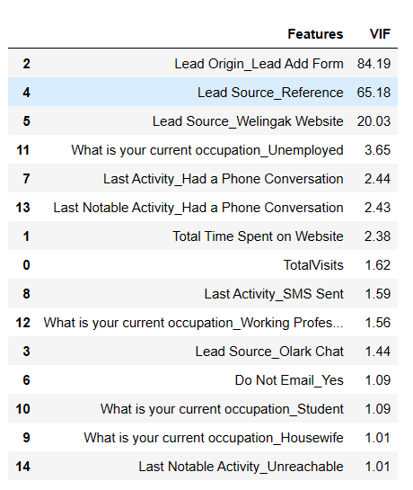
MODEL BUILDING
Import RFE and select 15 variables
Put all the columns selected by RFE in the variable 'col’
Fit a logistic Regression model on X_train after adding a constant and output the summary
Make a VIF dataframe for all the variables present
VIFs seem to be in a decent range except for ‘Lead Origin_Lead Add Form’, ‘Lead ‘Source_Reference’ and ‘Lead Source_Welingak Website’. Let's first drop the variable ‘Lead Source_Reference’ since it has a high p-value as well as a high VIF.
Refit the model with the new set of features
Building Model by removing the variable whose p- value is greater than 0.05 and vif value is greater than 5%
Predictions on test data set
Overall accuracy 79%

Slide 10
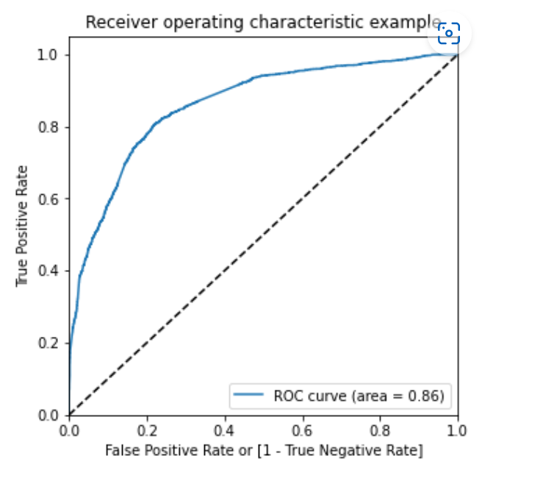
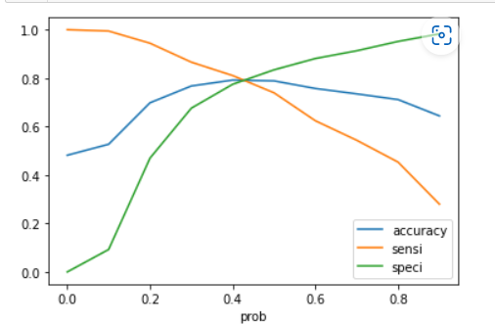
ROC CURVE
Finding Optimal Cut off Point
Optimal cut off probability is that probability where we get balanced sensitivity and specificity.
From the second graph it is visible that the optimal cut off is at 0.41.

Slide 11
CONCLUSION
It was found that the variables that mattered the most in the potential buyers are (In descending order) :
The total time spend on the Website.
Total number of visits.
When the lead source was:
Google
Direct traffic
Organic search
Welingak website
When the last activity was:
SMS
Olark chat conversation
When the lead origin is Lead add format.
When their current occupation is as a working professional. Keeping these in mind the X Education can flourish as they have a very high chance to get almost all the potential buyers to change their mind and buy their courses.

Slide 12
THANK YOU

